Slide 1
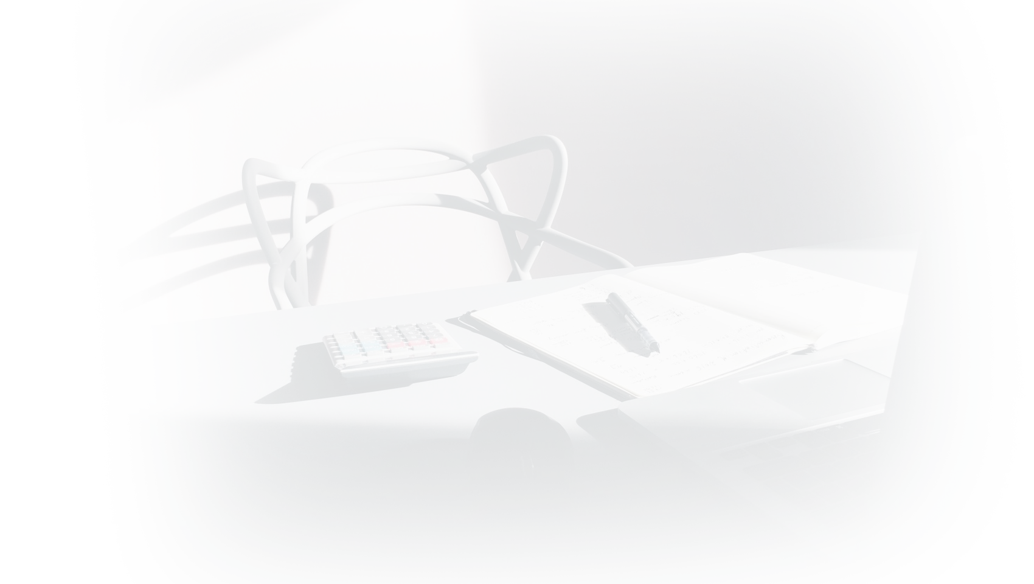

Trial Project
Braze, Inc.
1

Slide 2



Client:
West Elm is a platform that offers modern furniture and home décor featuring inspiring designs and colors with global presence, 85+ cities in the United States itself. It offers kitchenware, houseware, office furniture, home furnishings, linen, upholstery, and more.
2

Slide 3
Know the Brand
Business Model: Deliver deeper and more meaningful customer experiences in all aspects of their lives at home, work and away by converting these innovative brand experiences into sales.
West Elm designs the majority of its items in-house, allowing it to control its offering of organic, sustainably sourced, and Fair Trade Certified products. In 2014, it became the first-ever US home retailer to offer Fair Trade Certified products.
Brand offerings like Home Installation, In-Store Design Services & Room Planner not only increases store sales but also online sales of partner brands (William Sonoma, Pottery Barn, Mark and Graham, Rejuvenation).
3
3

Slide 4

Target Audience
HENRYs (high-earners-not-rich-yet) are the key demographic customer for their market. Aged between 24-40 years with income levels of ($100k-$250K).
Household with 2
or more people
Gender
Eco Conscious
Consumer
4

Slide 5

Current Marketing Strategies
Print Media - Catalog
Content Marketing
Mobile Shopping Ads
Local Community Programs - In each location, they broaden their partnerships with both the makers and designers through their local program, garnering big interest from both customers and communities
YouTube channel
Customer Match for Shopping (Google’s re-engagement tool)
TV Ad campaign
Display Ads/Social Media Marketing using #mywestelm tag (retargeting, acquisition, brand awareness)
Email Campaigns
5

Slide 6
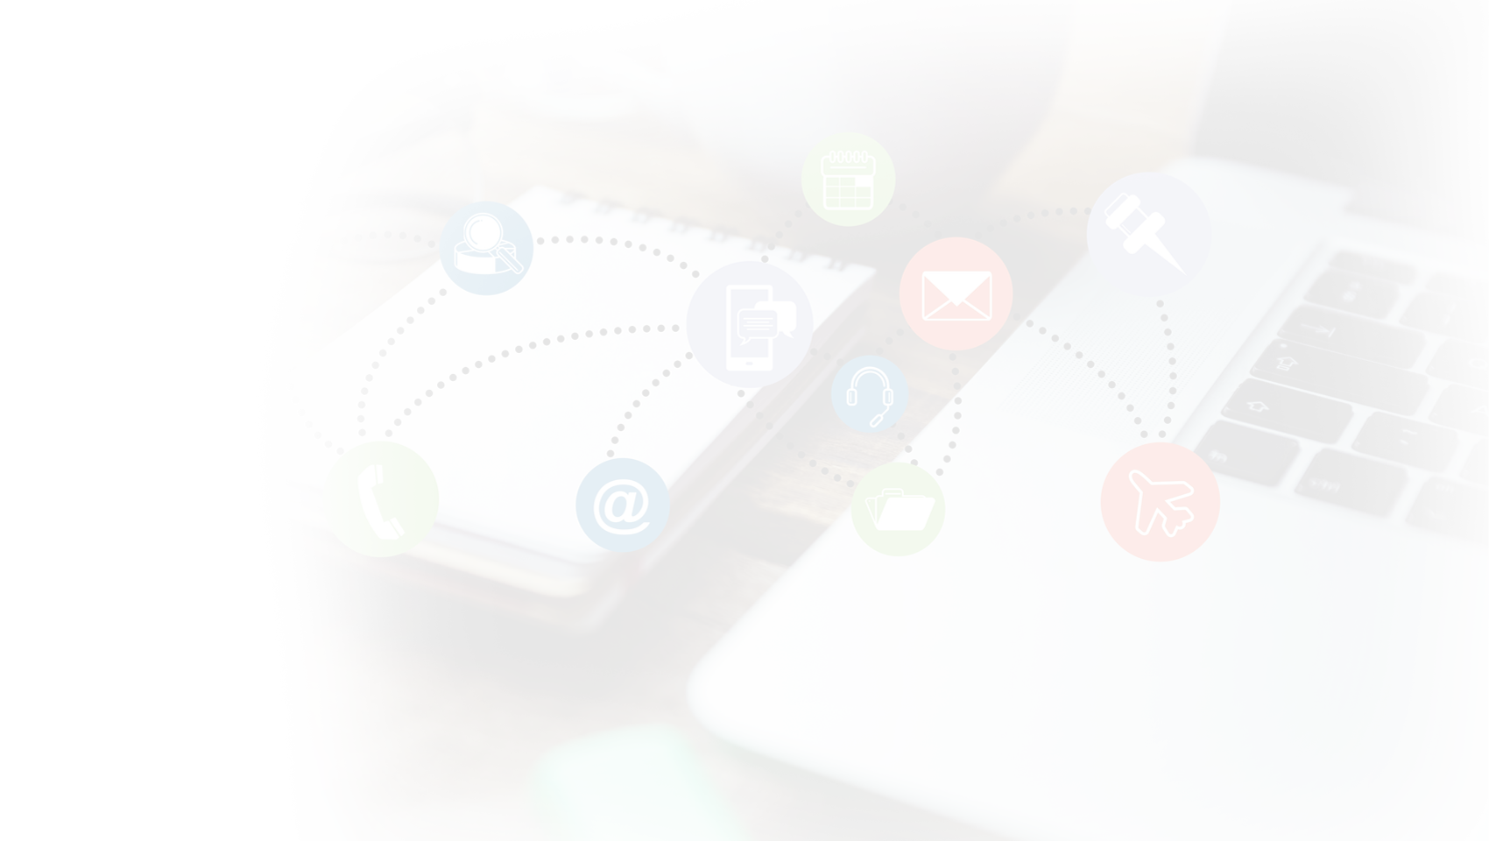
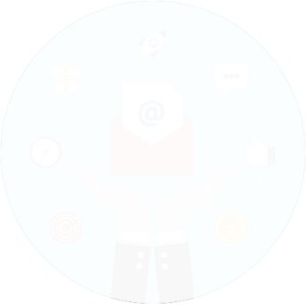

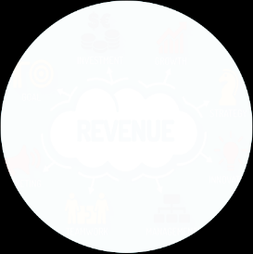
Deliverability
Open Rate
CTR
Conversion Rate
Bounce Rate
Unsub Rate
Abuse Reports
Session info (duration and interval)
Abandonment Rate
Lifetime Value (LTV)
Retention Rate
Attrition Rate
Conversion Rate
Email
Marketing
KPIs
User
Engagement
KPI’s
Key Performance
Indicator
Sales &
Revenue
Revenue per customer | Total Revenue | Total Sales | Conversion/Response Rate | Visits/Conversions/Revenue Per Channel
6

Slide 7








Challenges
West Elm is a great place where they appeal to a really broad group, from designers to empty nesters to those furnishing their first apartments. But the challenge there is, how do they improve the mobile app experience of the engaged shopper by making it more personalized & providing it a human touch.
App does not allow Notifications.
Not using In-App messaging
No personalized recommendations
4
Not Targeting on Psychographic factors (Lifestyle/Values/Attitudes)
Special Events/Classes - No Notifications/Alerts/Emails based on the shopper’s interest.
No notification on key rewards (cash earned) that users earn, this could create interest for purchase.
6
No Cart Abandonment Notification
7
7

Slide 8
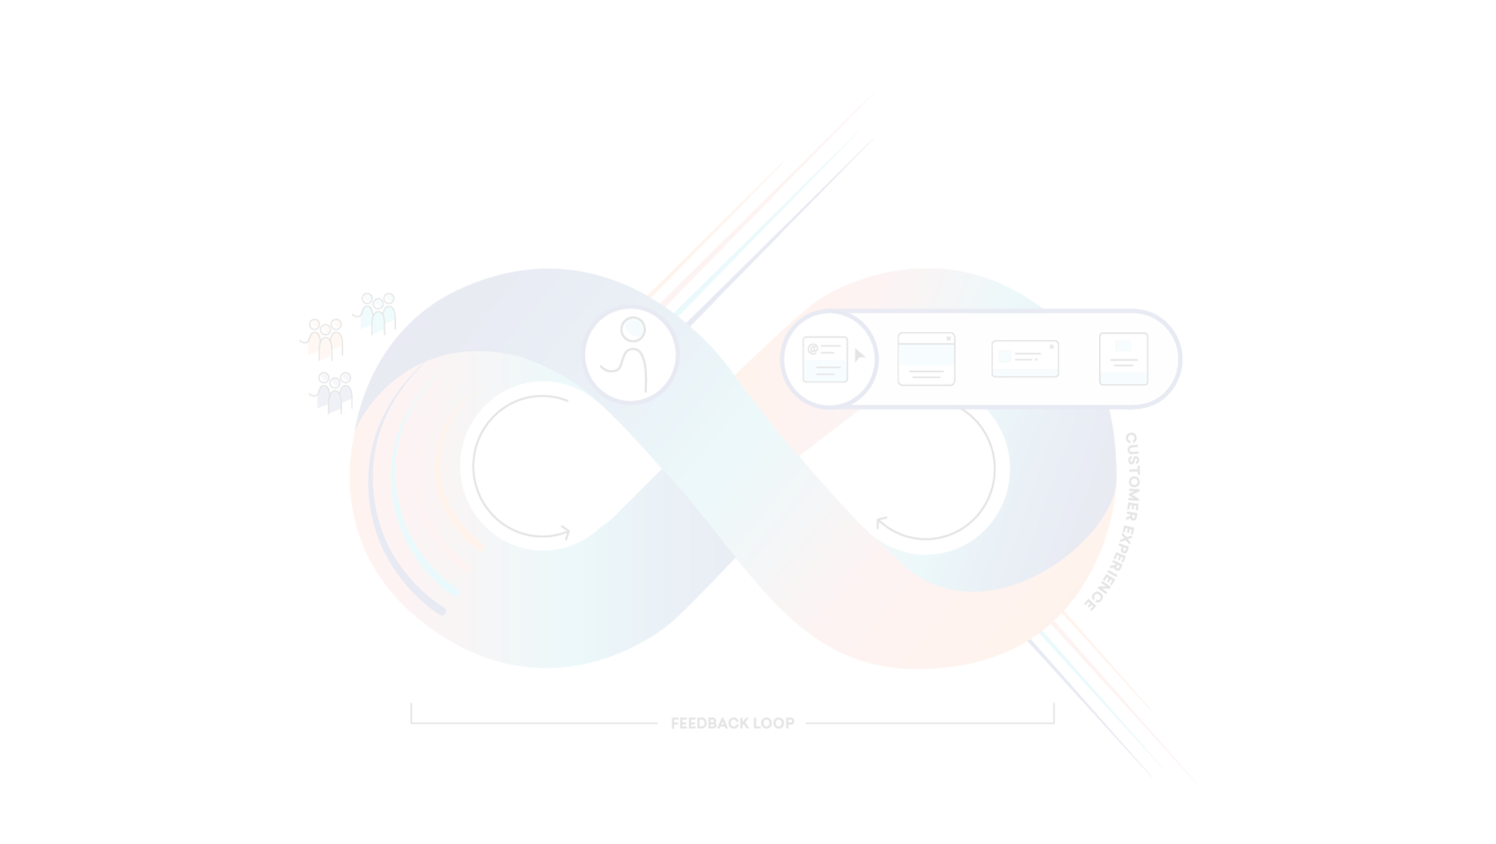
Braze Features
Cross-Channel Personalization
Lifecycle Engagement Orchestration
Email
Canvas - our visual customer journey tool
Email Editor & Customizable templates
Capture Prime Inbox real estate
Innovate Through Iteration
Optimization and AI
Data Agility and Management
Mobile
Currents, our data streaming tool, allows you to
send data in just a few clicks. You'll get actionable
insights in milliseconds.
Push Notification
In-App Messaging
Content Cards
Email
Braze Alloys
Web
Our Technology Partners to harness the power of partnerships to create more brilliant experiences.
Web Push Notification
In-Browser Messaging
Content Cards
Email
8

Slide 9
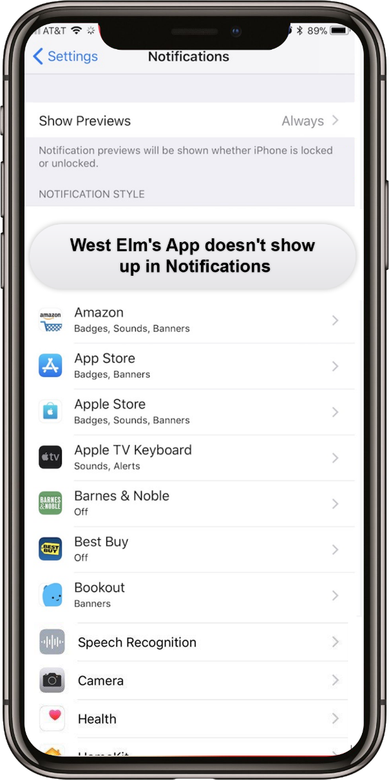
Use Case 1: App Push Notifications
Currently, West Elm's app doesn’t show in the notification center for a user to allow receiving notifications impacting:
User engagement - Several key campaign objectives are impacted like personalized messages based on:
user’s browsing/shopping history
special classes/events (Per shopper’s interest & activity)
promotional offers
LTV & Revenue
Retention and Upsell
Even though the app is available and operational to buy products, track orders, add items to registry; it’s not using the platform’s unparalleled ability to engage the audience impacting the retention rate and the power to upsell.
Since push notifications appear front and center on the device even if the recipient isn’t using your app the odds are good that your message will be seen. That means that when you absolutely, positively need to reach a customer, push may well be the best way
9

Slide 10
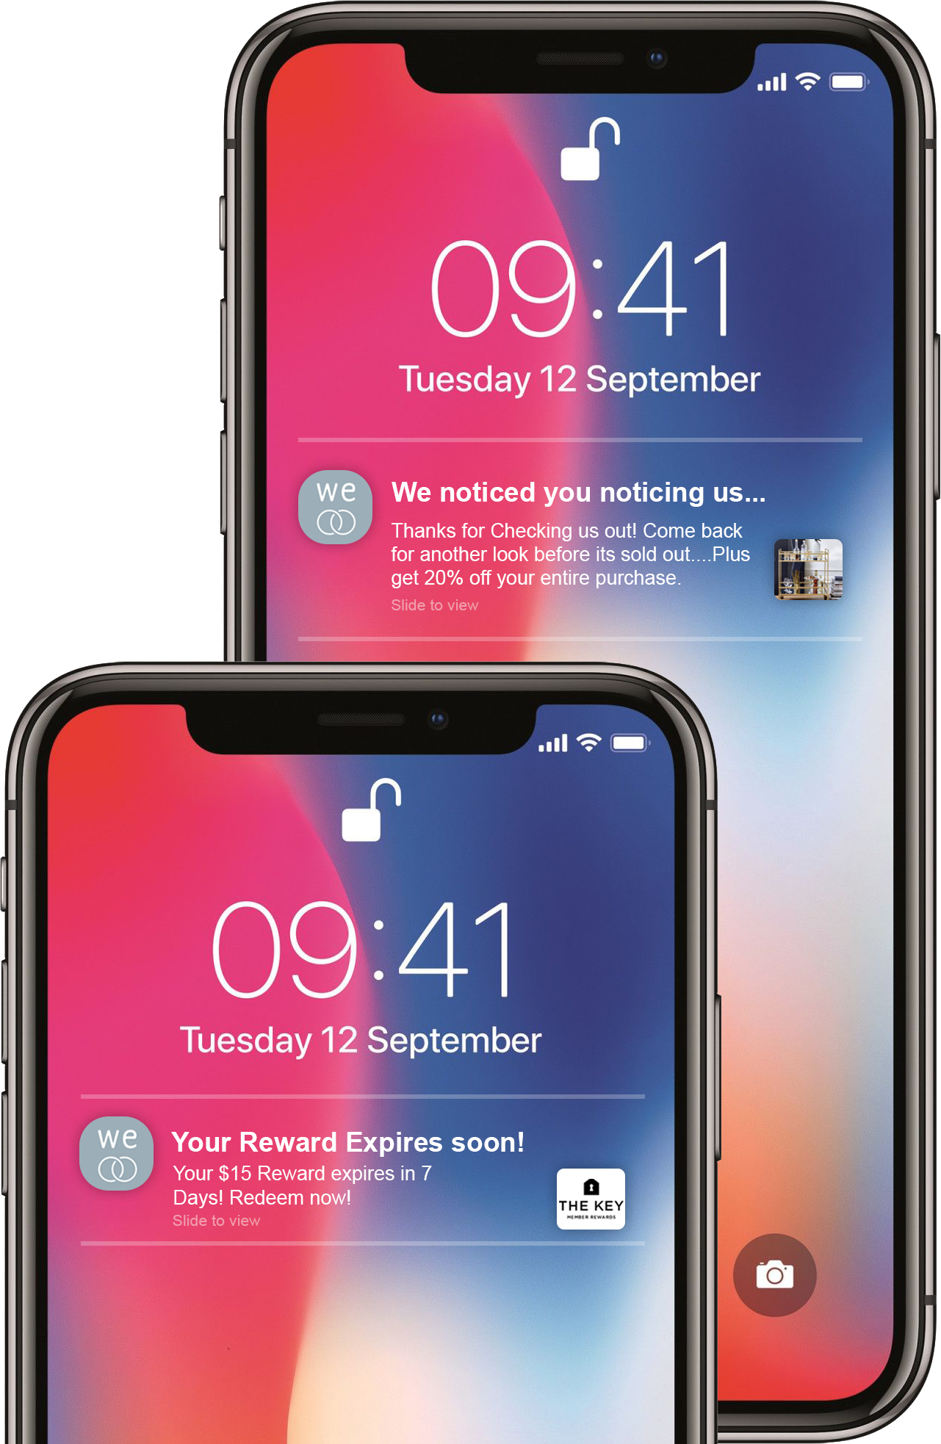
Use Case 1 -Braze’s Power
Push messaging is a powerful engagement tool for cementing customer relationships and boosting revenue. It is great at prompting customers to open apps, so it’s key if you’re looking to re-engage lapsing or inactive members. When used well you can drive up engagement, conversions, and ROI, and hold onto customers who might otherwise slip away.
With Braze:
See and be seen across channels. Engage customers as they jump from email to your app, to mobile and the web, with rich, responsive experiences they won’t forget. Keep up with your customers using a highly adaptive mobile strategy.
Personalize your push messaging to reflect specific customer behaviors, interests, preferences, and more.
You can also create interactive messaging with Push Stories, Push Action Buttons, and rich push notifications.
Success Story: Dots boosted their average LTV among all users by 25% and increased total revenue by 33% from just one campaign with Braze. #winning
10

Slide 11
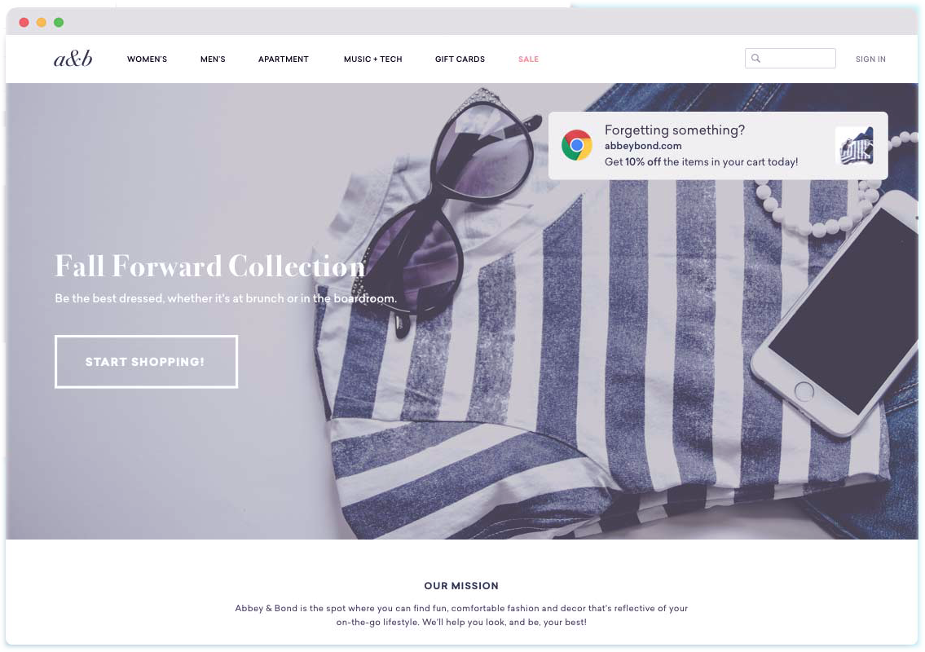
Use Case 2: Web Push Notifications
West Elm is not using Web Push notifications to communicate with the user. Like mobile app push, these messages are built for short, urgent communications, but can support rich content like images in a pinch.
How does it impact?
Easy Subscription - No PII is required.
Privacy Protection - Permission-based Communication Channel.
Higher Click Through Rates
Instant Delivery
Communicate with web visitors - whether they’re not on your website
Reduction in Cart Abandonment Rate
Increased User Engagement
11

Slide 12
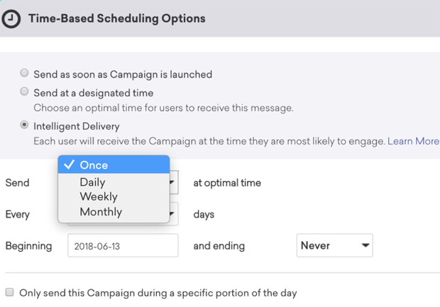
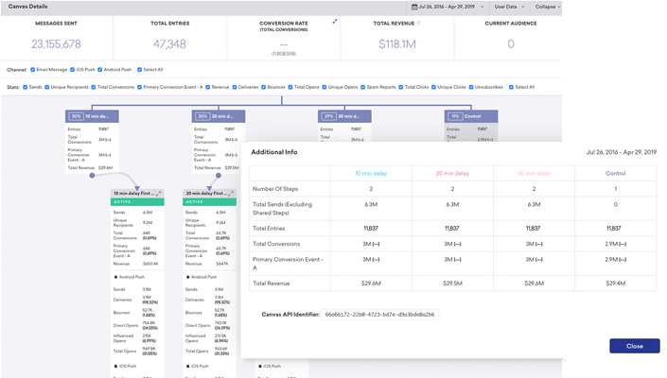
Use Case 2: Braze’s Power
Bring your customers back to your website with web push—short notifications that appear at the top right corner of your screen. Use Braze to share breaking news, promotions, and more with your web push subscribers (even when they’re not on your site).
Using Braze’s platform, you can create different marketing campaigns and :
Schedule Notifications: You can schedule when you want to send your notifications. This way you will never miss time-critical notifications
Drip Notifications: You can create a series of Web Push Notifications to nurture and educate users. This helps in converting leads to customers.
Segmentation: Notifications sent to segmented users can result in an increase in open rates and higher click rates as compared to non-segmented users.
12

Slide 13
Abandoned Cart Notifications: Create an abandoned cart campaign and convert them into customers with Web Push Notifications. Since push notifications are delivered in real time, it can lead to higher conversion.
Customization: Rich content notifications
Multi-Lingual Support: Ability to send notifications in different languages.
Success Story: 1-800-Flowers.com see a 350% increase in conversion over industry benchmark. They use Braze to determine the best messaging and send times for communications following abandoned cart sessions. A little A/B testing goes a long way.
12

Slide 14
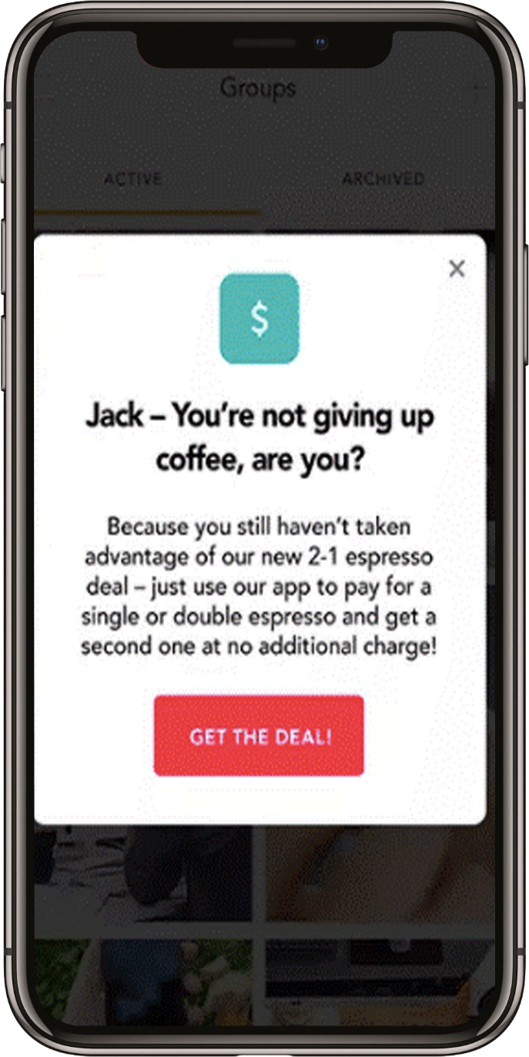
Use Case 3: In-app Messaging
Help your customers understand, explore, and engage with all sides of your app using in-app messages. They make for great tutorials, promotional slides, and more. Using this powerful tool, West elm will experience higher user retention and app engagement. Presently, the brand doesn’t use this channel in their marketing efforts.
Increase app launches - In-app messages can be used to help guide users, so that they know their next steps, or explain how a feature works.
Boost engagement with your app - These messages can help users achieve their goals and increase their satisfaction with the app.
Get personal with highly relevant content - In-app messages triggered by an event within the app can quadruple conversions. App users tend to expect a highly personalized experience, so delivering information that is relevant and timely can help to lead them to conversion.
Achieve Unparalleled Reach - Latest mobile engagement benchmarks reports found that high-performing message center content generates 8x the read rate alone, and when used in combination with a push notification, message center read rates more than double.
14

Slide 15
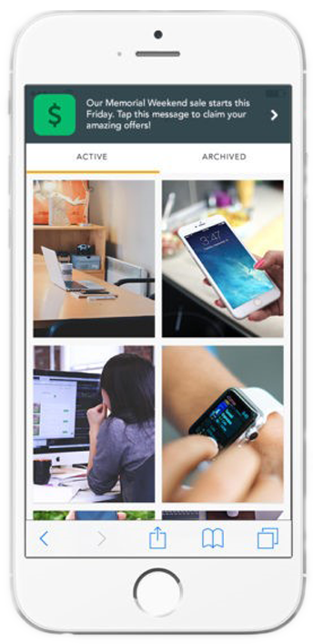
Use Case 3: Braze’s Power
Braze’s strategy is all about interaction & personalization. Our platform can help create an in-app messaging strategy that’s rooted in your user behaviors and analytics data.
Support An Overall Multichannel Messaging Strategy: When you think omnichannel, remember this type of message is your secret weapon. Push notifications can be turned off and email lists can be unsubscribed from, but in-app messages will be seen, and likely engaged with, as long as you have active users routinely opening up your app or visiting your website.
Act As The Personalized Storefront Window For Your Digital Enterprise: What’s the number one thing you want your customers to know, or the number one action you want them to take, when they visit your digital storefront (your app or website)? Use in-app and in-browser messages to share this information or call to action.
Successfully Onboard Customers: When welcoming new app users or website visitors, use in-app messages to convert customers to the next step in the process, such as creating an account, watching help materials, getting started using the app, or receiving push notifications.
Short and Sweet
15

Slide 16
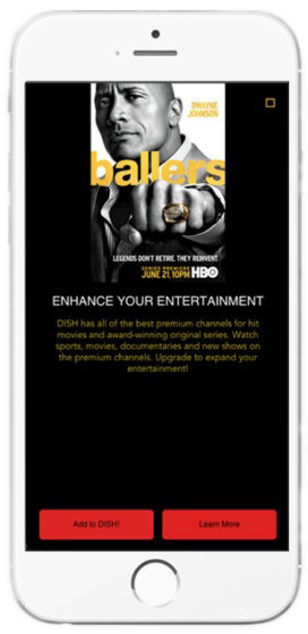
Help Retain And Share Important Updates With Lapsing Customers: Perhaps it’s been a while since a customer responded to email or push notifications. In-app messages, which are seen by everyone actively using the app, can be a great way to re-target individuals who have opted out of or aren’t engaging with other messaging types.
Engage Active And Loyal Customers: As you work toward developing long-term relationships and customer loyalty, in-app messaging can be a great asset.
Success Story: Rakuten's audience base involves a wide range of different segments, personas, experiences, and spots on the lifecycle and customer journey. Braze allows Rakuten to target down to the individual member with personalized content in the moment. 50% YOY GROWTH ON APP-EXCLUSIVE DAYS FEATURING HIGHER CASH BACK WITH MERCHANT PARTNERS
Deep and Rich
15

Slide 17
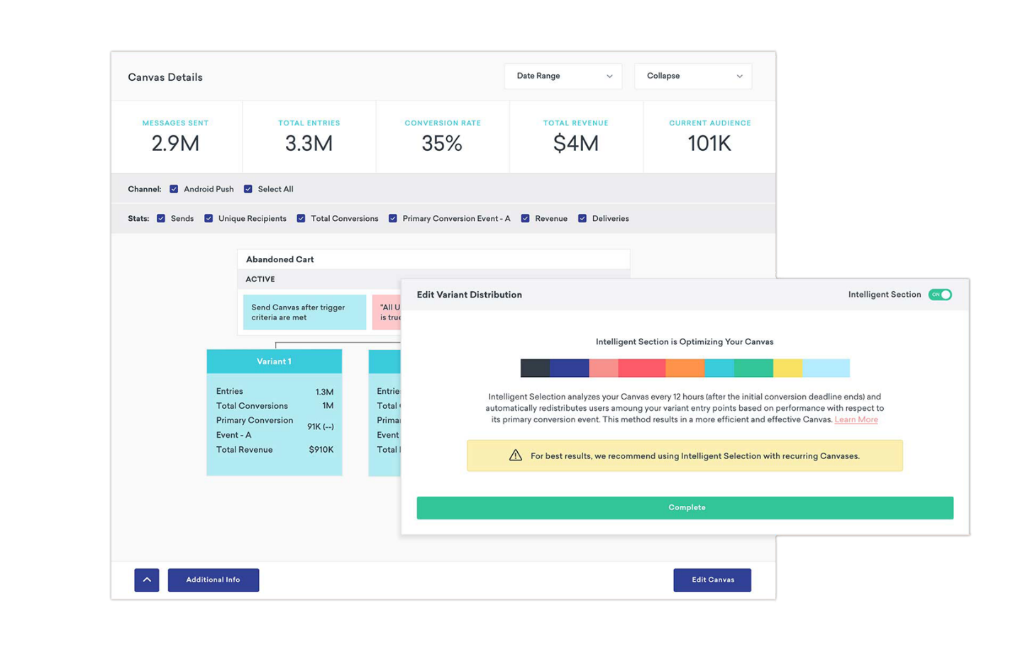
Optimization & AI
Clear next steps! Comprehensive reports and summaries
Nothing goes unnoticed—Braze offers detailed reports for every single campaign. Each includes integrated insights and tools for a cross-channel look at what you've achieved.
Predict and perform with AI
Our Intelligence Suite helps you tackle any situation that comes your way. It provides a powerful foundation of data-based suggestions that will help inform your creativity, leading to better insights and performance overall. It helps you reach for the stars with continuous testing of up to eight variants. See what comes out on top to inform the next round of experimentation on anything from channel mix to cadence, timing to segmentation.
After optimizing their campaigns with Braze, Urban Outfitters' overall message open rates jumped over 100%.
17

Slide 18
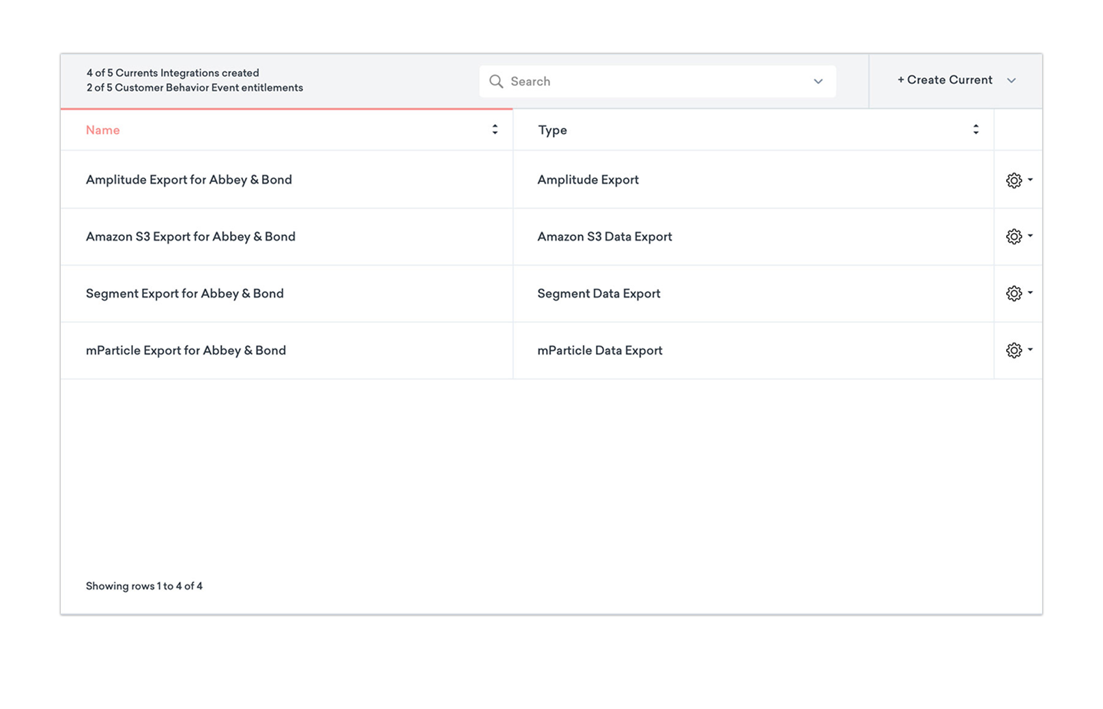
Data Agility & Management using Currents
Export data on the fly
When you need to analyze performance and optimize messaging, you shouldn't have to face long waits for data. Import and export high volumes of data in milliseconds with Currents, our data streaming tool.
Simple ways to add to your ecosystem
We play really well with other technologies. Connect Braze to your data warehouse, BI tools, POS systems, and other layers of your marketing technology stack.
Enterprise-grade security
Our enterprise-grade permissions systems and air-tight security functions work to keep your data safe and easy to manage on a global scale.
Postmates uses Currents to identify friction points and iterate on the fly. A moment to remember? That real-time optimization during their campaign with ABC’s The Bachelorette. #goals
18

Slide 19

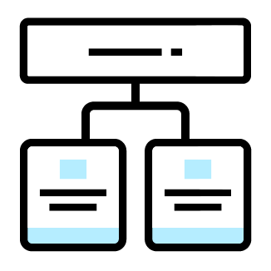
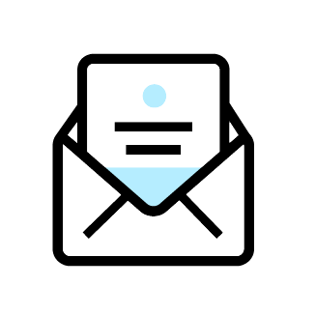



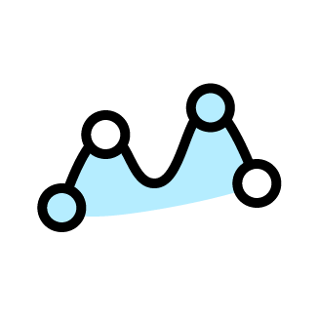
How can Braze help you? In one or many ways..
https://www.braze.com/product/packages/
Send personalized, timely messages across channels and devices.
Integrate email into my cross-channel approach.
Work with Braze to develop my lifecycle engagement strategy and business goals from onboarding to ongoing.
Stream engagement data to partners in real-time and high-volume.
Create and optimize cohesive cross-channel campaign using a easy-to-use visual customer journey tool.
Use geofences to trigger messages based on a customer's location and context.
Manage my cross-channel campaigns across multiple business units.
19

Slide 20
THANK YOU

